Slide 1
Tokyo in the Heart of NYC
By: Cedric Hage

Slide 2
Introduction
What are the strategic questions to ask when investing in a restaurant?
Strategic location
Targeted audience
Demand/Supply
Competition vs. Previous Experience

Slide 3
Data Acquisition and Cleaning
New York City Boroughs & Neighborhoods data from https://geo.nyu.edu/catalog/nyu_2451_34572 dataset
Venues locations, names, & categories called using the Foursquare API
Duplicate, highly similar or highly correlated features were dropped.
Cleaned data contains 4 features

Slide 4
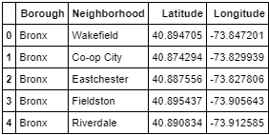
Neighborhood Dataset
Neighborhood/Borough location
306 rows =306 neighborhoods
5 borrows

Slide 5
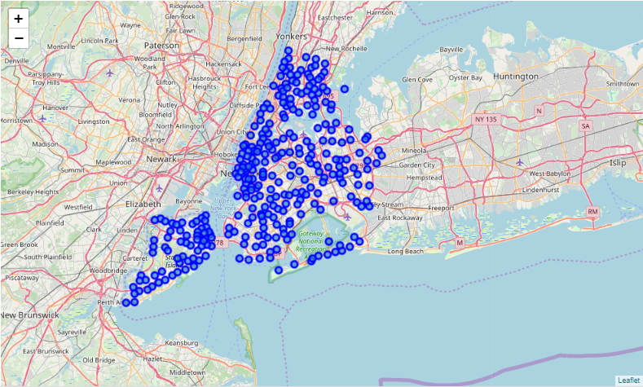
New York Neighborhood Markings

Slide 6
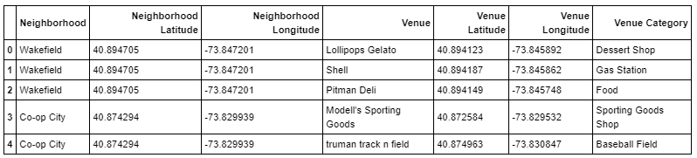
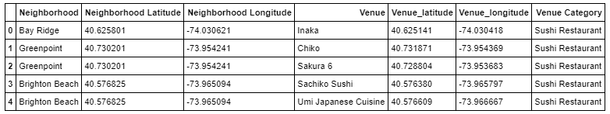
Foursquare Call Dataset/Filtered
Table 1 represents all respective venues from our Foursquare call
Table 2 represents our filtered venues obtaining our desired Japanese cuisine venues
2643 Venues and 7 attributes

Slide 7
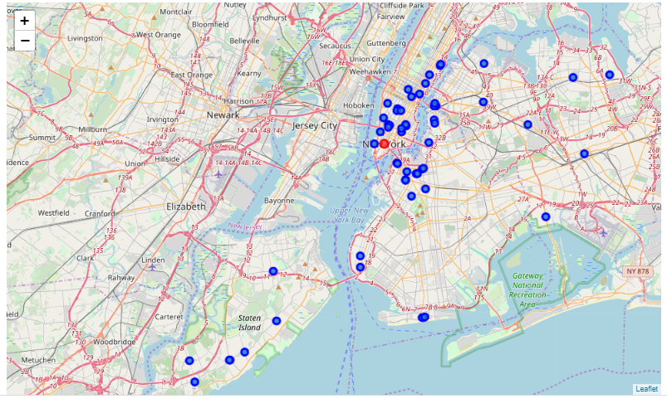
Chinese Cuisine Visualization
Red marker represents New York City Hall
Blue markers represents the distribution of Japanese Cuisine restaurants around multiple New York Neighborhoods

Slide 8
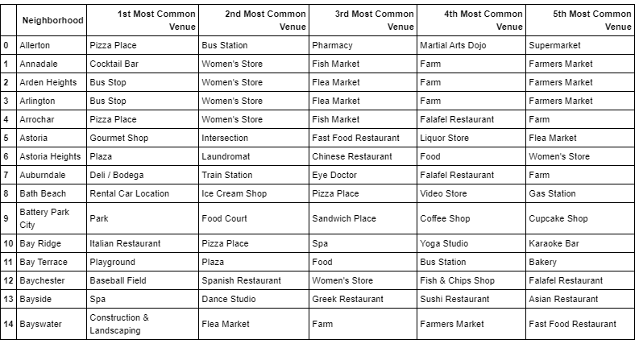
Popularity of Venues
Popularity based on frequency of visits
Venues having Japanese cuisine as top 3 filtered from dataset

Slide 9
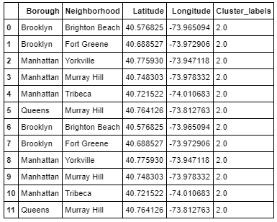
Optimal Sushi Restaurant Locations
6 locations having 1st , 2nd, or 3rd or even both Japanese and Sushi restaurants as most common venues
Divided into clusters of neighborhoods of similar venue popularity

Slide 10
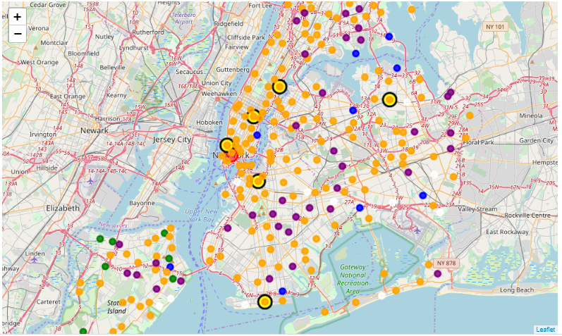
Final Outcome
Investor to choose one of the 6 available yellow markers as they are the best location for investing in a Sushi Restaurant
Analysis open for further research based on more features than demographics and frequency of visits

Slide 11
THANK YOU

